Slide 1
Automatic Topic Identification in Destination Review using Hybrid Topic Modelling Techniques Final Team ID: P-122 Panel No.:
Amrita School of Computing, Bangalore Campus
Department of Computer Science and Engineering
21CSE495 – Project Phase – 1
S.No | Reg.No | Name of the Student | Branch & Section
1 | BL.EN.U4CSE20092 | M. Nitin Sai | CSE-B
2 | BL.EN.U4CSE20109 | N N V Siva Sai Raghu | CSE-B
3 | BL.EN.U4CSE20113 | N.Chakravarthi | CSE-B
4 | BL.EN.U4CSE20114 | N.Leeladhar Royal | CSE-B
Project Guide: Dr.Deepa Gupta, Professor
Amrita School of Computing, Bengaluru

Slide 2
Problem Definition
"The problem at hand is to build a hybrid topic modeling approach proposed for analyzing tourism-related data. Specifically, the problem involves exploring the applications of large language models (LLMs) and advanced clustering algorithms or metaheuristic optimization techniques to enhance the accuracy and effectiveness of topic identification and clustering within the tourism domain. "

Slide 3
Literature Survey
Paper Title and year | Authors And paper details | Description | Gaps
Topic modeling using latent Dirichlet allocation: a survey Published Year-2021 | Umang Chauhan, Apoorva Shah Published in ACM Computing Surveys(CSUR) As an article in a journal. | The paper delves right into a complete overview of Latent Dirichlet Allocation(LDA) inside the context of topic modelling. It explores LDA’s importance in Natural Language Processing and its applications in regions like text mining and information retrieval. The authors goes into detail about the LDA’s ideas, such as report clustering and sentiment analysis. | This paper do not address real world issues such as hyperparameter tuning and preprocessing, which are essential if we want to use LDA for real world applications.
Paper Title and year | Authors And paper details | Description | Gaps
"Enhancing Latent Dirichlet Allocation for Unsupervised Sentiment Analysis" (2019) | Authors and Paper Details: Yifan Peng, Zhiyong Cheng, Dan Yang; Presented at the 2019 International Conference on Artificial Intelligence and Computer Science (ICAICS 2019 | The paper proposes innovative enhancements to the traditional Latent Dirichlet Allocation (LDA) model specifically designed for unsupervised sentiment analysis tasks. The research aims to improve the existing LDA framework by integrating sentiment analysis capabilities, facilitating a more nuanced understanding of sentiment within topic modeling | The paper addresses the need for more refined topic-sentiment modeling approaches within unsupervised learning paradigms. It emphasizes the exploration of effective strategies to seamlessly integrate sentiment analysis into LDA, offering insights into improved unsupervised sentiment analysis frameworks

Slide 4
Literature Survey
Paper Title And year | Authors And paper details | Description | Gaps
How smart is e-tourism? Published Year-2021 | Hamid, R. A., Albahri, A. S., Alwan, J. K., Al-Qaysi, Z., Albahri, O. S., Zaidan, A., Alnoor, A., Alamoodi, A. H., Zaidan, B. Published in-Computer Science Review as a Journal. | The article, which was released in 2021, offers a thorough analysis of smart tourist recommendation systems with a special emphasis on data management in e-tourism. It examines the most recent advancements in smart tourism technology and offers information on data-driven strategies for improving the traveller experience. | The need for inclusion of emerging technologies the and more recent advancements in smart tourism, and a deeper investigation of the problems with data management for e-tourism systems are a few potential gaps.

Slide 5
Literature Survey
Paper Title and year | Authors and paper details | Description | Gaps
A novel content-based recommendation approach based on LDA topic modeling for literature recommendation. Published Year-2021 | Bagul DV Barve S Published in IEEE as a conference paper. | The paper introduces a novel content-based recommendation approach for literature recommendation. It utilizes Latent Dirichlet Allocation (LDA) topic modeling to extract topics from the literature dataset and then recommends relevant literature based on these topics. The goal is to enhance the quality of literature recommendations by taking into consideration the semantic content of the documents, providing users with more personalized and effective recommendations. | While the paper introduces an interesting approach to literature recommendation, there are several potential research gaps that could be addressed such as Evaluation Metrices, Scalability.
Paper Title and year | Authors and paper details | Description | Gaps
BERT: Pre-training of Deep Bidirectional Transformers for Language Understanding | Jacob Devlin, Ming-Wei Chang, Kenton Lee, Kristina Toutanova Published in: Conference of the North American Chapter of the Association for Computational Linguistics (NAACL-HLT) 2019 | This paper introduced BERT, a novel language representation model based on the transformer architecture. BERT was designed for pre-training bidirectional representations from unlabeled text by jointly conditioning on both left and right context in all layers. It demonstrated state-of-the-art performance on various natural language understanding tasks, showcasing the effectiveness of bidirectional context representations in language modeling. | The paper addressed the need for more robust and context-aware language representation models by introducing bidirectional contextual learning. It highlighted the significance of bidirectional transformers in capturing intricate contextual information in natural language processing tasks.

Slide 6
Literature Survey
Paper Title and year | Authors and paper details | Description | Gaps
Sentiment classification of tourism. Published Year-2019 | Chen, B., Fan, L., Fu, X. Published in IEEE as a conference paper. | This 2019 paper employs the Latent Dirichlet Allocation (LDA) topic model in conjunction with rules to classify sentiment in tourism. It examines how these methods are used to evaluate and categorize sentiment in the tourism industry. | The potential gaps would include the demand for more contemporary sentiment analysis methods and an examination of the practical difficulties in applying sentiment analysis in the tourism sector.
Paper Title and year | Authors and paper details | Description | Gaps
"Language Models are Unsupervised Multitask Learners" (2019) | Alec Radford, Karthik Narasimhan, Tim Salimans, Ilya Sutskever; Published by OpenAI as a Technical Report | This paper introduces the GPT-2 (Generative Pre-trained Transformer 2) language model, which operates as an unsupervised multitask learner. GPT-2 is based on a transformer architecture trained on a wide range of language tasks without task-specific supervision. The model demonstrates strong performance in various natural language processing benchmarks, displaying capabilities in language understanding, translation, and generation tasks. | The paper addresses the need for language models capable of multitasking and unsupervised learning, focusing on the development of transformer-based architectures that excel in comprehending and generating human-like text without task-specific annotations.

Slide 7
Literature Survey
Paper Title and year | Authors and paper details | Description | Gaps
Framework for Topic Modeling using BERT, LDA, and k-means Published Year-2022 | Sethia K, Saxena M, Goyal M, Yadav RK Published in ICACITE as conference paper. | The framework for topic modeling presented in this 2022 paper makes use of three different techniques: BERT, LDA, and k-means. It addresses the applications of these strategies as well as how they can be combined to improve subject modeling. | Potential gaps include the need for assessments of how effectively the proposed framework is working and comparisons to other approaches, as well as insights into its difficulties and constraints.

Slide 8
Literature Survey
Paper Title and year | Authors and paper details | Description | Gaps
Event detection in social media via graph neural network Published Year-2021 | Gao W Fang Y Li L Tao X Published in Springer as Conference paper. | This paper focuses on event detection in social media and proposes a method that leverages graph neural networks (GNNs) for this task. The authors aim to detect and identify events or incidents in social media data by modeling the data as a graph and using GNNs to analyze the relationships and patterns within the data. The paper likely discusses the methodology, experiments, and results related to using GNNs for event detection in the context of social media. | potential research gaps regarding the need for comprehensive assessments of the proposed framework's effectiveness, comparisons to other event detection approaches, and insights into the difficulties and constraints faced when applying GNNs to this domain.

Slide 9
Literature Survey
Paper Title and year | Authors and paper details | Description | Gaps
"English text analysis system based on genetic algorithm” Published Year-2022 | Jian Yao Jin Xu Published in Hindawi as a paper. | The limitations and shortcomings of mutual information (MI) and information gain (IG) for text classification are discussed in this paper. The statistical dependence between two variables is measured by the MI. MI variation created exclusively for feature selection is called IG. | We need more reliable and effective feature selection techniques for classifying text and strategies for selecting features by taking into account how they interact.

Slide 10
Literature Summary
The paper "Event Detection in Social Media via Graph Neural Network" investigates how Graph Neural Networks can aid in identifying and analyzing events within social media, a task crucial for understanding trends and patterns in online discourse.
We used this paper to know how data format will affect our work, like how the authors used graphs to identify events happening in social media.
The paper "Enriched Latent Dirichlet Allocation for Sentiment Analysis" study offer advancements in sentiment analysis by enhancing the Latent Dirichlet Allocation (LDA) technique, improving its efficacy in extracting sentiment-related information from text. We referenced this paper to study about LDA and its inner working along with it’s advantages and disadvantages.
The paper "BERT: Pre-training of Deep Bidirectional Transformers for Language Understanding" outlines the BERT model, a state-of-the-art language understanding model that has significantly advanced natural language processing tasks. This paper has everything we needed to know about BERT and helped us quite dearly.
These papers collectively cover a broad spectrum of topics in natural language processing, sentiment analysis, recommendation systems, and event detection in social media, contributing valuable insights and methodologies to their respective fields of study.

Slide 11
Literature Summary
The paper "A novel content-based recommendation approach based on LDA topic modeling for literature recommendation". This work introduced an innovative approach that utilizes LDA topic modeling for content-based literature recommendations, aiming to enhance recommendation systems in the academic domain. Our work as some similarity with this paper making us select this paper.
"Language Models are Unsupervised Multitask Learners" contributes to the understanding of language models' unsupervised learning capabilities. This work delves into how language models, specifically unsupervised ones, can learn and perform multiple tasks without explicit supervision.
The paper “Enriched Latent Dirichlet Allocation for Sentiment Analysis” explores advancements in sentiment analysis using an enriched version of Latent Dirichlet Allocation (LDA). LDA, a popular topic modeling technique, is enhanced to better capture sentiment-related information from textual data. The aim is to improve the accuracy and effectiveness of sentiment analysis in extracting nuanced emotional tones or opinions from text.
The paper “BERT: Pre-training of Deep Bidirectional Transformers for Language Understanding” introduces BERT, a groundbreaking language understanding model. BERT, short for Bidirectional Encoder Representations from Transformers, significantly advances natural language processing tasks by pre-training on a large corpus of text.

Slide 12
Justification for the Proposed Problem
Gain insights into customer behavior. By understanding the topics that customers are talking about, businesses can gain insights into their behavior and preferences.
Identify trends in the tourism industry. By tracking the topics that are being discussed over time, businesses can identify trends in the industry and adapt their strategies accordingly.
Tourism businesses can use the results of our project to improve their customer satisfaction. Tourism businesses can use the results of your project to target their marketing campaigns more effectively. By understanding the interests and preferences of their target audience, businesses can develop marketing campaigns that are more likely to resonate with potential customers.
Overall the project has the potential to make a significant contribution to the field of tourism research and practice. By providing a novel and effective method for identifying topics from tourism reviews, your project can help businesses to improve customer satisfaction, develop new products and services, and target their marketing campaigns more effectively.

Slide 13
Software/Tools Requirements
Natural Language Processing (NLP) Libraries:
NLTK (Natural Language Toolkit): Provides a suite of tools for natural language processing, including tokenization, tagging, lemmatization, and part-of-speech tagging.
sklearn: A machine learning library that includes the LatentDirichletAllocation class for topic modeling and the KMeans class for clustering.
Genism library for LDA model creation. Corpora in genism to create the id2word Dictionary and corpus of terms .
Deep Learning Libraries:
Transformers: A library for natural language processing with pre-trained models, including GPT2Tokenizer and GPT2Model.
Data Visualization Library:
Matplotlib: A library for creating plots and charts.
Other Libraries:
torch: A library for tensor computation and deep learning.
NumPy: A library for numerical computation and data manipulation.
model viz.

Slide 14
Data Set
Source of data set:
tripadvisor.in
The dataset was built in the Human Language Technology Laboratory by Dr.Manju Venugopalan and Dr.Deepa Gupta. The dataset is a valuable resource for researchers in the field of natural language processing.
The Dataset contains raw data streamed from approximately 1 lakh reviews.
dataset consists of seven distinct groups and a single miscellaneous group.
The seven distinct groups are:
Amusement Parks, Beaches and Lakes, Historic Places, Museum, National Parks, Scenic Places.
Of given huge dataset we concentrated on Karnataka popular tourist state, 11 destinations to be exact. The reviews on these tourist destinations consitute of 10,000 reviews.

Slide 15
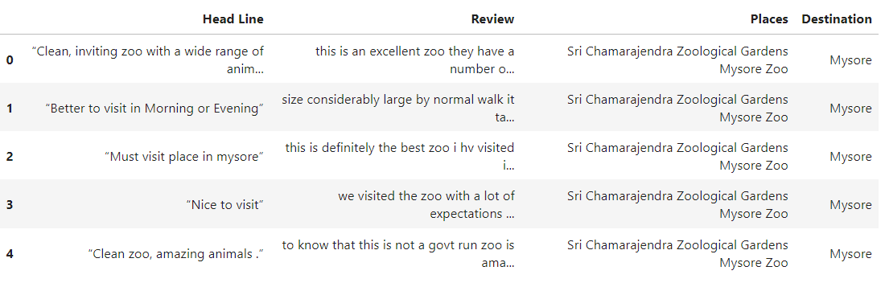
Data Set

Slide 16
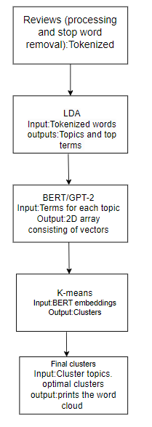
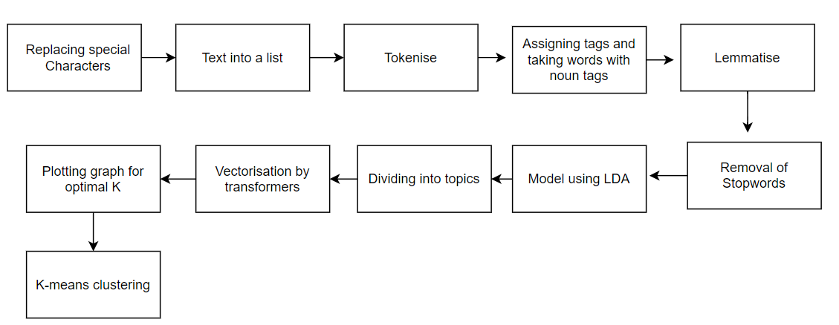
Architecture
Fig: Design in Detail
Fig: Overall Architecture

Slide 17
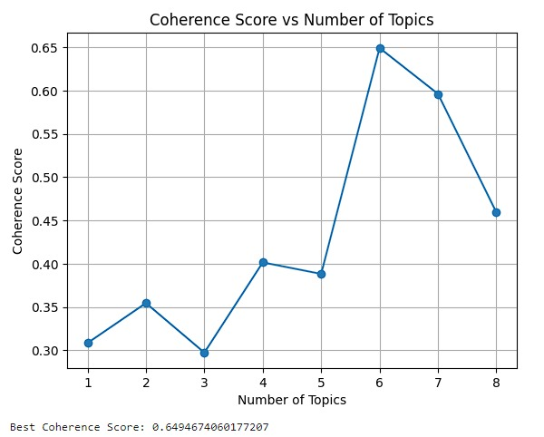
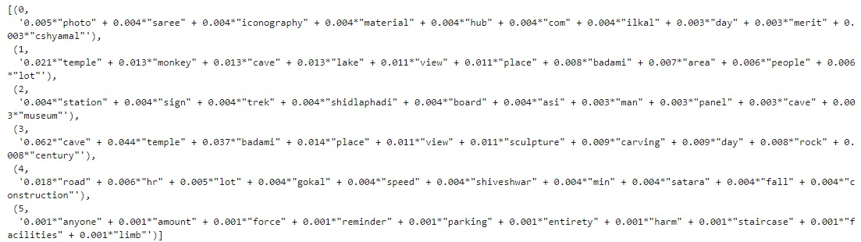
Implementation(Badami)
Throughout the collection of reviews, we used Latent Dirichlet Allocation (LDA) to find latent themes or subjects. Using co-occurrence patterns, LDA is a statistical technique that classifies words into topics. This stage aids in identifying the recurrent themes expressed in the reviews.
To assess the caliber of the selected topics, we computed coherence ratings. Coherence ratings assess a topic's interpretability and semantic consistency. More significant and well-defined subjects are indicated by higher coherence ratings. The initial experiments with the model yielded a coherence score of 0.64 for six topics.

Slide 18
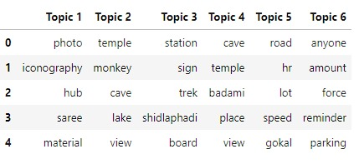
Output of the LDA

Slide 19
BERT
Visualization of Frequency: Word clouds visually represent the frequency or occurrence of words within a body of text. The size of each word in the cloud corresponds to its frequency in the text dataset or document. Larger words indicate higher occurrence, allowing for a quick understanding of the most prevalent or important terms.
At-a-Glance Representation: They offer an at-a-glance representation of prominent terms or themes within a dataset. This visual method condenses information, making it easier for viewers to identify common patterns, central themes, or prevalent topics within a corpus of text.
Limited Contextual Information: While word clouds are excellent for highlighting popular terms, they lack the context or relationships between words. They don't convey the connections, nuances, or the specific context in which words appear. Hence, they are best used in conjunction with other analysis methods to provide a more comprehensive understanding of the data.
Notes:
628 length, 13 vectors, last 4 layers add gives the thing we got

Slide 20
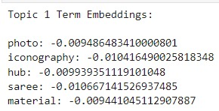
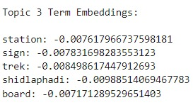
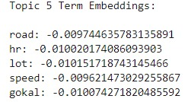
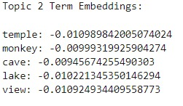
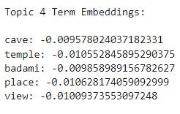
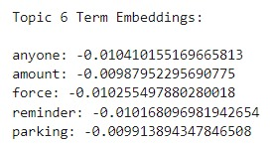
BERT
Notes:
628 length, 13 vectors, last 4 layers add gives the thing we got

Slide 21
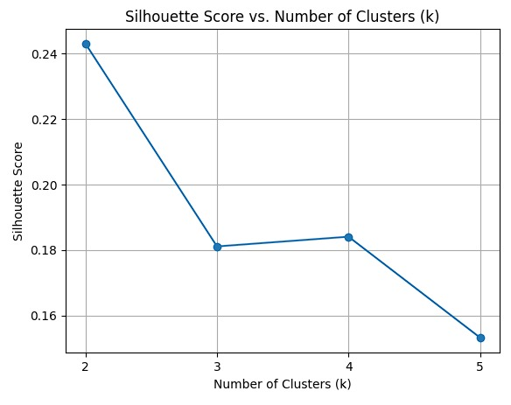
Finding Optimal value of k

Slide 22
Word Cloud
Visualization of Frequency: Word clouds visually represent the frequency or occurrence of words within a body of text. The size of each word in the cloud corresponds to its frequency in the text dataset or document. Larger words indicate higher occurrence, allowing for a quick understanding of the most prevalent or important terms.
At-a-Glance Representation: They offer an at-a-glance representation of prominent terms or themes within a dataset. This visual method condenses information, making it easier for viewers to identify common patterns, central themes, or prevalent topics within a corpus of text.
Limited Contextual Information: While word clouds are excellent for highlighting popular terms, they lack the context or relationships between words. They don't convey the connections, nuances, or the specific context in which words appear. Hence, they are best used in conjunction with other analysis methods to provide a more comprehensive understanding of the data.

Slide 23
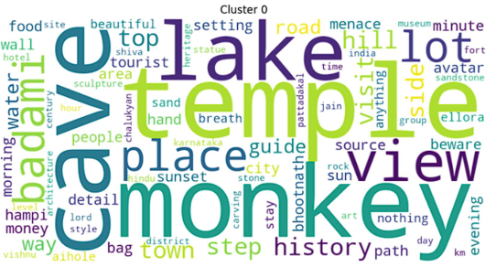
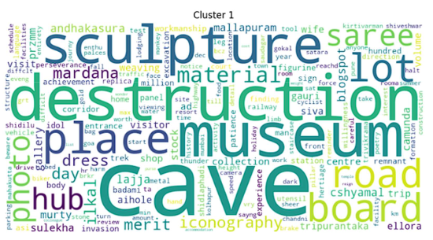
Results for Badami(BERT)
Cluster 0: Badami Cave Temples: This cluster seems to focus on the Badami cave temples in Karnataka, India. Words like "cave", "temple", "Badami", "sculpture", and "pillar" are prominent. Chalukyan Art and Architecture: Words like "Chalukyan", "sculpture", "art", "pillar", "architecture", and "Hampi" suggest a focus on the artistic and architectural style of the Chalukya dynasty, who built the Badami caves.
Cluster 1: Ellora Caves: This cluster seems to focus on the Ellora Caves, another famous group of rockcut cave temples in Maharashtra, India. Words like "Ellora", "cave", "sculpture", "Ajanta", and "Ellora" are prominent. Religious Diversity: Words like "Hindu", "Buddhist", "Jain", "temple", and "sculpture" suggest a focus on the religious diversity of the Ellora caves, which contain temples and monuments of all three religions.

Slide 24
Implementation Results
To improve the representation of the review text, we looked into using BERT or GPT-2 embeddings. These methods translate words into vector representations that describe word semantic associations. To further evaluate the topic modeling process, we introduced the silhouette score, which measures the separation between clusters. The silhouette score for K-means clusters was 0.25.
We next replaced BERT embeddings with GPT-2 embeddings and got a silhouette score of 0.35 for six topics which is higher than the scores obtained with BERT embeddings, indicating that GPT-2 embeddings can improve the quality of topic modelling.
These findings suggest that GPT-2 embeddings provide a promising approach for enhancing the quality of topic modelling, potentially leading to more meaningful and interpretable results.
Then we group our findings using k-means, optimal k value is found via graph.

Slide 25
GPT-2
Language Generation: GPT-2, developed by OpenAI, is a state-of-the-art language generation model. It uses a transformer architecture, capable of understanding and generating human-like text based on the input it receives.2.
Size and Capabilities: GPT-2 was notable for its large scale, consisting of 1.5 billion parameters (or weights) in its network. This vast size enabled it to generate impressively coherent and contextually relevant text across a wide range of topics, making it versatile for various language tasks.3.
Controversy and Controlled Release: Upon its development, there were concerns about potential misuse of GPT-2 to generate misleading or harmful content. Due to this, OpenAI initially chose not to release the full version immediately, opting for a phased release to minimize potential negative impacts.
Notes:
628 length, 13 vectors, last 4 layers add gives the thing we got

Slide 26
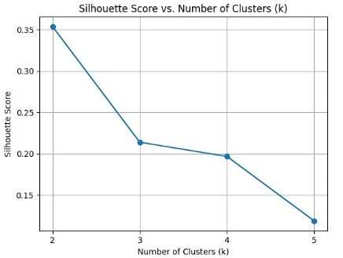
Finding Optimal value of k

Slide 27
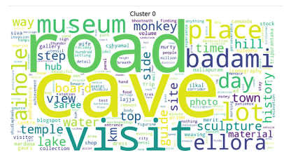
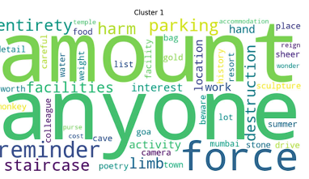
Results for Badami(GPT-2)
Cluster 0: Tourism and Local Culture: Words like "tourist", "way", "place", "museum", "shop", and "saree" suggest a focus on tourism and the local culture surrounding the caves.
Cluster 1: Monkeys and Nature: Words like "monkey", "wildlife", "forest", "nature", "tree", and "hill" suggest a focus on the monkeys and the natural environment around the Badami caves. Photography and Travel: Words like "camera", "photo", "trip", "trek", and "view" suggest a focus on photography and travel experiences related to the monkeys and the caves.

Slide 28
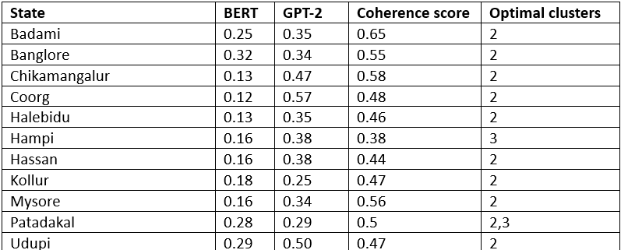
Results

Slide 29
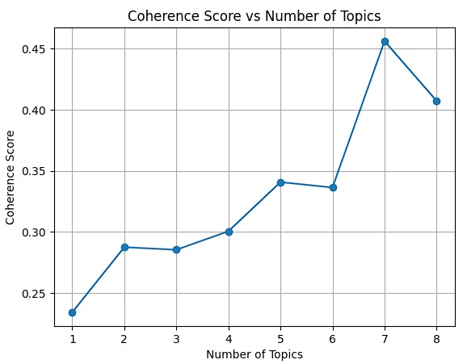
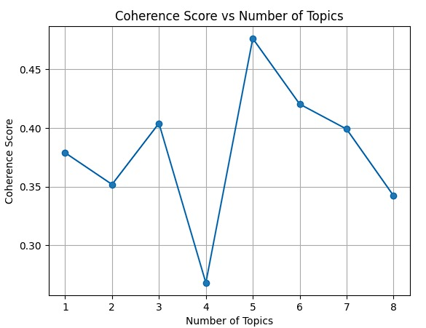
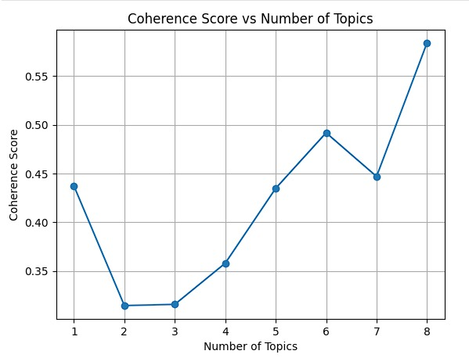
Coherence Score vs No of cluster graphs for 4 different cities
Halebidu
Coorg
Chikamangalur
Badami

Slide 30
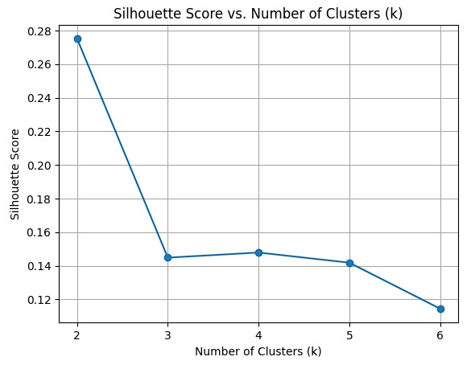
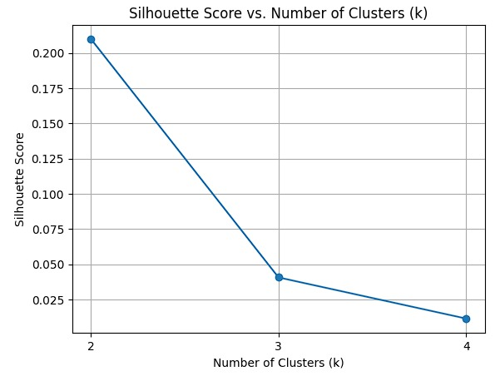
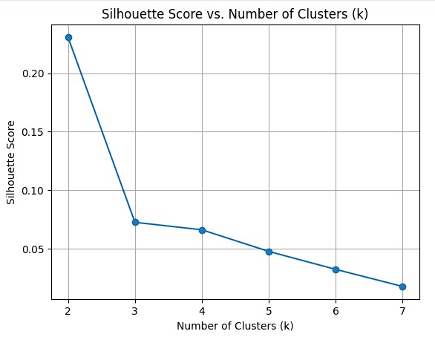
Silhouette Score vs No of cluster graphs for 4 different cities
Optimal value of K is found.
BERT:
Halebidu
Coorg:
Chikamangalur
Badami

Slide 31
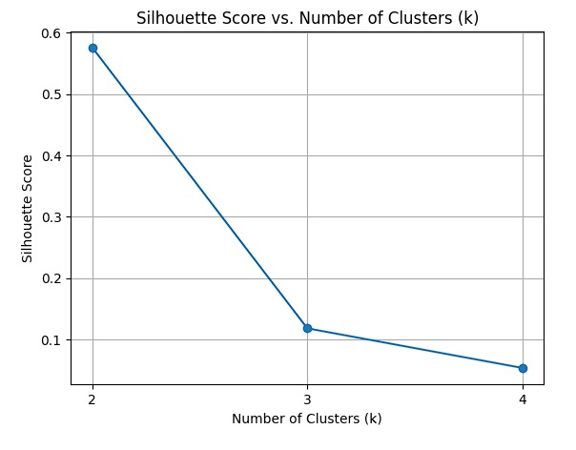
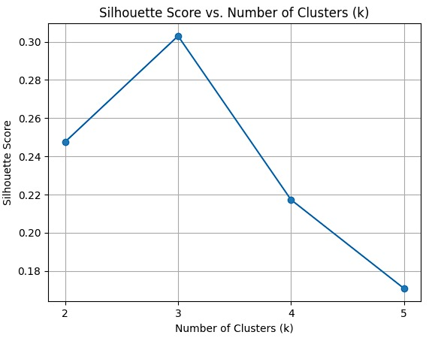
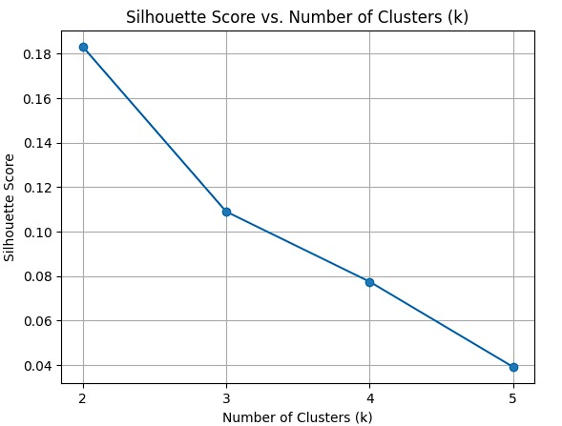
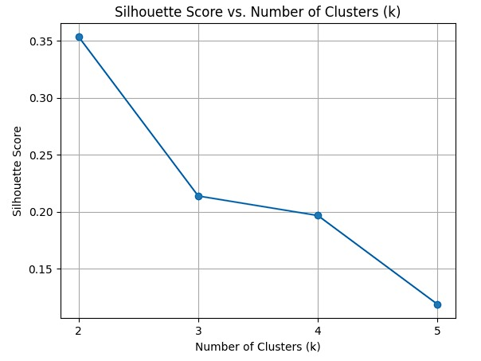
Silhouette Score vs No of cluster graphs for 4 different cities
Optimal value of K is found.
GPT-2:

Slide 32
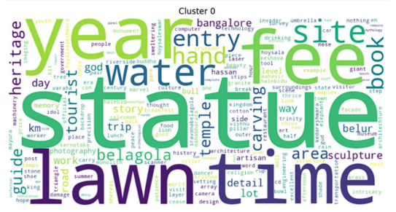
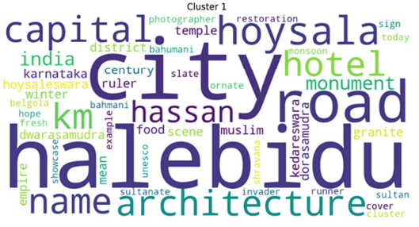
Results for Halebidu(BERT)
Cluster 0: Hoysala architecture and art-This cluster features many words related to the specific style of architecture and art found in the Hoysala temples, such as "Hoysala," "architecture," "sculpture," "temple," and "carving." Religious and mythological themes: Words like "Vishnu," "pillar," "god," "mythology," and "story" suggest this cluster is about the religious and mythological themes depicted in the temple carvings and sculptures.
Cluster 1: History and heritage: Words like "history," "heritage," "ancient," "king," and "empire" indicate this cluster is about the historical and cultural significance of the Hoysala temples. Tourism and travel: Words like "tourist," "travel," "place," "visit," and "camera" suggest this cluster is about the experience of visiƟng the temples as a tourist or traveler

Slide 33
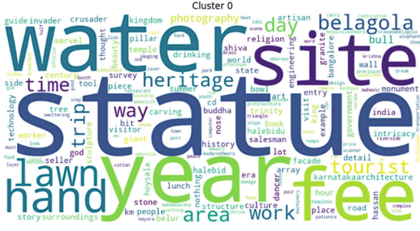
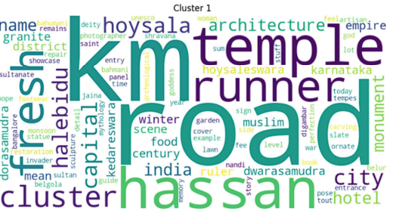
Results for Halebidu(GPT-2)
Cluster 0: Halebidu Hoysala Temple: This cluster includes words like "Halebidu," "Hoysala," "temple," "monument," and "architecture." These words suggest that this cluster is specifically about the Halebidu Hoysala Temple, its architecture, and its significance. Intricate carvings and sculptures: Words like "carving," "sculpture," "detail," "intricate," and "facade" highlight the intricate and detailed carvings and sculptures that are a defining feature of the Halebidu Hoysala Temple.
Cluster 1: Tourism and visitor experience: Words like "tourist," "visitor," "camera," "guide," and "souvenir" suggest that this cluster is about the experience of visiƟng the Halebidu Hoysala Temple as a tourist. History and cultural heritage: Words like "history," "heritage," "ancient," "dynasty," and "empire" indicate that this cluster is about the historical and cultural significance of the Halebidu Hoysala Temple and the Hoysala dynasty.

Slide 34
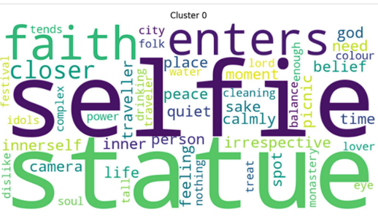
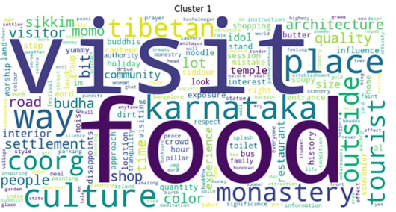
Results for Coorg(BERT)
Cluster 0: Food- This cluster features many words related to food, such as "momo," "noodle," "coffee," "tea," and “tibetan." Local experience: Words like "local," "authentic," "village," "homestay," and "people" suggest this cluster is about experiencing the local culture and food.
Cluster 1: Sightseeing and landmarks: Words like "monastery," "temple," "buddha," "sightseeing," and "place" indicate this cluster is about visiƟng and learning about the religious and historical landmarks of the area. Travel and acƟviƟes: Words like "travel," "tour," "trek," "bike," and "raŌing" suggest this cluster is about the various travel acƟviƟes and experiences in the area

Slide 35
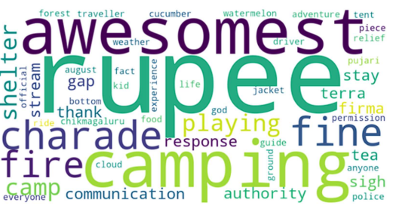
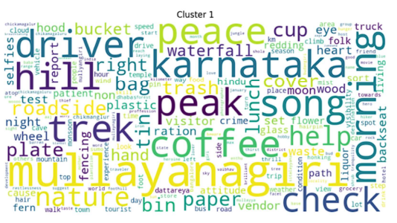
Results for Chikamangalur(BERT)
Cluster 0: Travel and adventure-This cluster includes words like "forest," "traveler," "adventure," "tent," and "waterfall." These words suggest that this cluster is about the thrill of traveling and exploring new places. Nature and the outdoors: This cluster also includes words like "nature," "mountain," "sun," and "rain." These words suggest that this cluster is about the beauty and wonder of the natural world.
Cluster 1: Peace and relaxation: This cluster includes words like "peace," "relax," "calm," and "tranquility." These words suggest that this cluster is about finding inner peace and relaxation. Community and connection: This cluster also includes words like "people," "friends," "family," and "together." These words suggest that this cluster is about the importance of social connection and communit

Slide 36
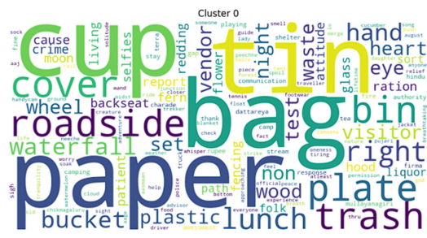
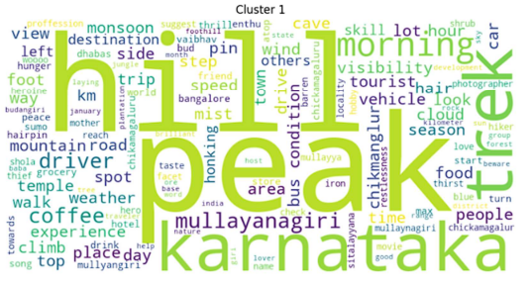
Results for Chikamangalur(GPT-2)
Cluster 0: Hiking and trekking: Words like "trek," "hike," "peak," "mountain," and "shola" suggest this cluster is about the physical acƟvity of hiking and trekking in these areas.
Cluster 1: Travel experiences: Words like "travel," "trip," "journey," "experience," and "place" suggest this cluster is about the broader experiences of travel, not limited to just hiking. Nature and scenery: Words like "waterfall," "sun," "cloud," "forest," and "view" indicate this cluster is about the natural beauty of the places visited. The words in the first cluster are mostly related to food, such as "food," "restaurant," "cuisine," "dish," and "eat." The words in the second cluster are mostly related to travel, such as "travel," "tourism," "city," "visit," and "place.

Slide 37
Conclusion
The proposed algorithm successfully extracts and visualizes semantic topics from destination reviews, providing valuable insights into traveler opinions and preferences. It achieves this through a multi-step process that combines the strengths of various techniques:
1. Topic Discovery:
LDA effectively identifies initial topics within the reviews, offering a broad overview of recurring themes.
BERT/GPT-2 enhances topic coherence and semantic understanding by generating contextual word embeddings.
K-means clustering organizes and refines topics based on embedding similarities, producing more distinct and meaningful clusters.

Slide 38
Conclusion
2. Topic Visualization:
Word clouds serve as an intuitive visual representation of the most prominent terms within each topic, enabling easy interpretation and exploration.
3. Topic Estimation:
While direct topic prediction from word clouds remains a challenge due to their inherent lack of structured information, the algorithm's systematic approach provides a reliable basis for human estimation. By carefully examining the word clouds and considering their context, domain experts can accurately infer the underlying themes.
Additional Considerations:
The use of silhouette scores and coherence metrics ensures the quality and interpretability of the extracted topics.
Further research could explore potential methods for directly predicting topics from word clouds, potentially leveraging advancements in natural language processing and machine learning techniques.

Slide 39
Conclusion
Overall:
The algorithm demonstrates a promising approach to topic modeling in destination reviews, offering valuable insights for tourism organizations, travel platforms, and researchers. Its ability to extract meaningful topics and present them visually enhances understanding of traveler experiences and preferences, informing marketing strategies, product development, and destination management.

Slide 40
References
[1]Chauhan U, Shah A (2021) "Topic modeling using latent Dirichlet allocation: a survey." ACM Comput Surv (CSUR) 54(7):1–35.
[2]Hamid, R. A., Albahri, A. S., Alwan, J. K., Al-Qaysi, Z., Albahri, O. S., Zaidan, A., Alnoor, A., Alamoodi, A. H., & Zaidan, B. (2021). How smart is e-tourism? A systematic review of smart tourism recommendation system applying data management. Computer Sci Rev, 39, 100337.
[3] Chen, B., Fan, L., & Fu, X. (2019). Sentiment classification of tourism based on rules and LDA topic model. In 2019 International Conference on Electronic Engineering and Informatics (EEI) (pp. 471–475). IEEE.
[4] Yao J, Xu J (2022) "English text analysis system based on genetic algorithm." Mob Inf Syst. https://doi.org/10.1155/2022/9382890
[5] Sethia K, Saxena M, Goyal M, Yadav RK (2022) "Framework for topic modeling using BERT, LDA and k-means." In: 2022 2nd International conference on advance computing and innovative technologies in engineering (ICACITE), pp 2204–2208.

Slide 41
References
[6] Event Detection in Social Media via Graph Neural NetworkWeb Information Systems Engineering – WISE 2021, 2021, Volume 13080ISBN : 978-3-030-90887-4Wang Gao, Yuan Fang, Lin Li, Xiaohui Tao.
[7] Osmani, Amjad & Bagherzadeh, J. & Soleimanian Gharehchopogh, Farhad. (2020). Enriched Latent Dirichlet Allocation for Sentiment Analysis. Expert Systems. 37. 10.1111/exsy.12527.
[8] Devlin, Jacob et al. “BERT: Pre-training of Deep Bidirectional Transformers for Language Understanding.” North American Chapter of the Association for Computational Linguistics (2019).
[9] Radford, Alec et al. “Language Models are Unsupervised Multitask Learners.” (2019).
[10] D. V. Bagul and S. Barve, "A novel content-based recommendation approach based on LDA topic modeling for literature recommendation," 2021 6th International Conference on Inventive Computation Technologies (ICICT), Coimbatore, India, 2021, pp. 954-961, doi: 10.1109/ICICT50816.2021.9358561.

Slide 42
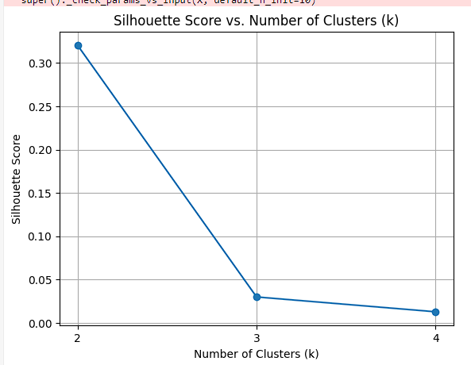
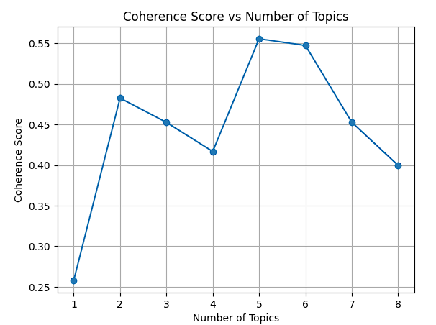
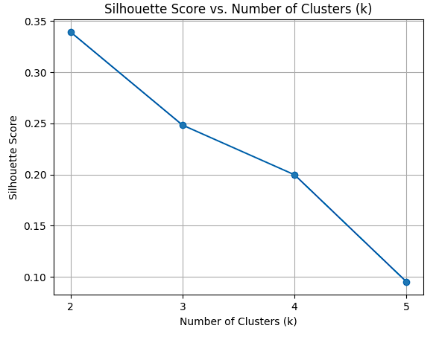
bangalore

Slide 43
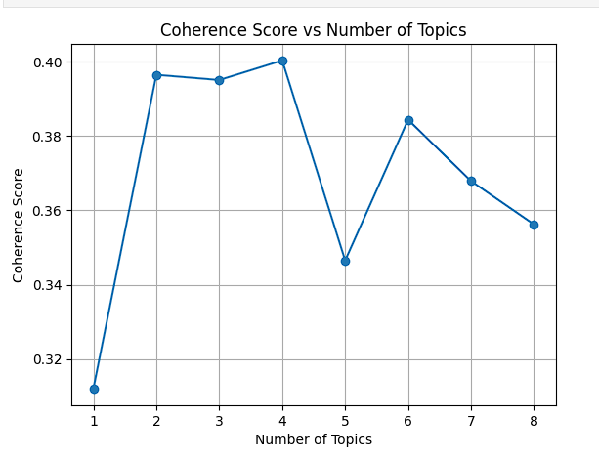
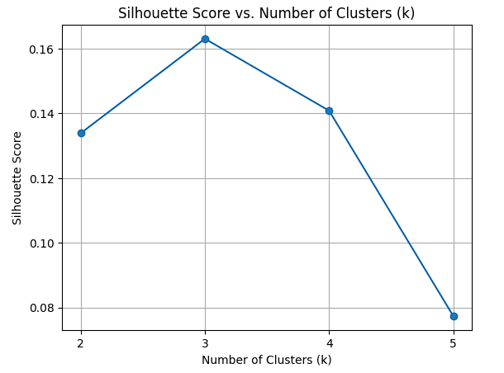
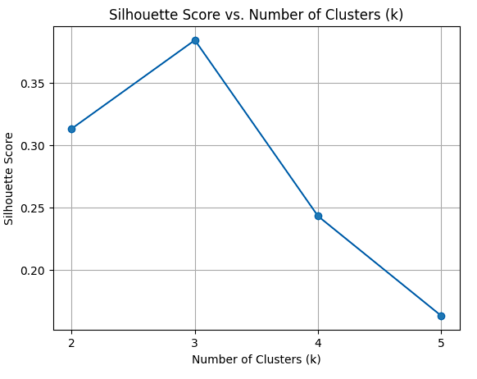
Hampi

Slide 44
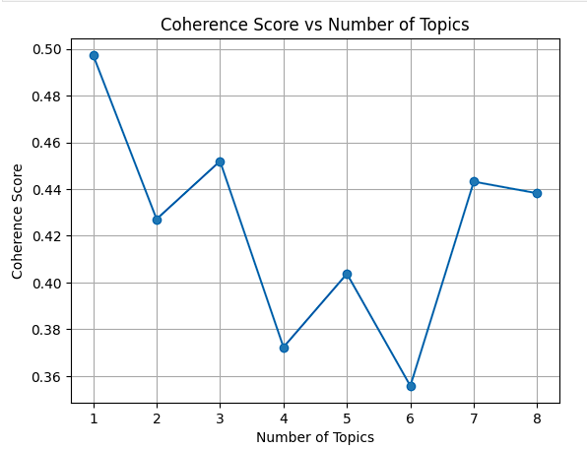
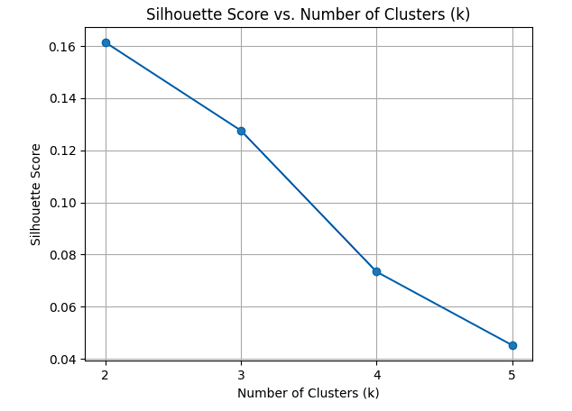
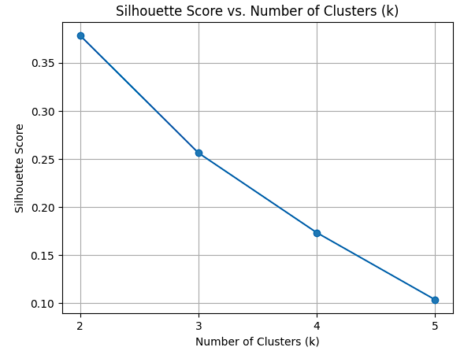
Hassan

Slide 45
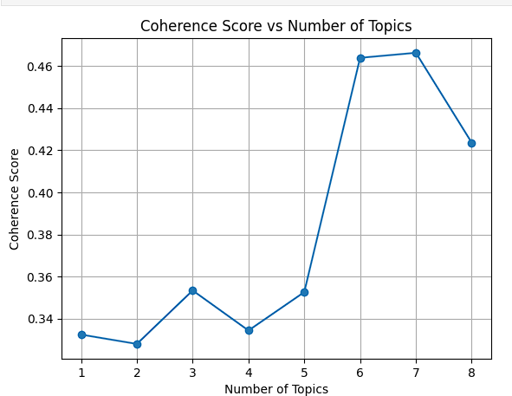
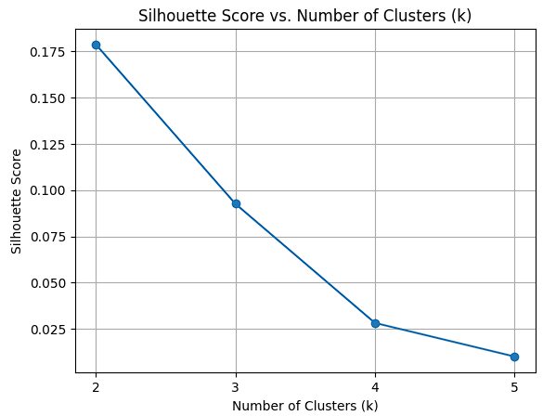

Kollur

Slide 46



Mysore

Slide 47



Pattadakal

Slide 48



Udupi

Slide 49
THANK YOU

